Slide 1


LS-PAC Models

Slide 2





System Features
Chat
Feed
Matching

Slide 3







Slide 4















ECMAScript 6
JavaScript

Slide 5




ECMAScript 6
JavaScript

Slide 6


Slide 7

Future Goals
Improve Android UI and Functionality
Improve Matching Algorithm
Restructure Data Management to Improve Fluidity and Efficiency
Add More Settings Features

Slide 8

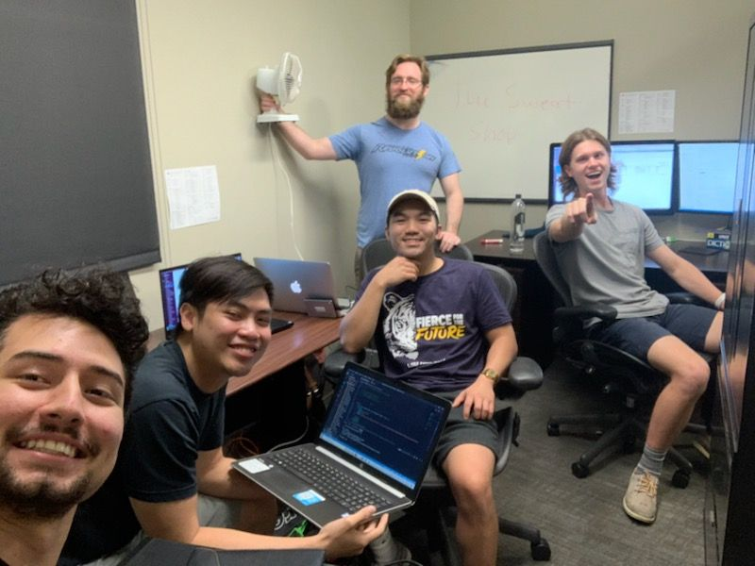
Meet The Developers
Walter Scott
Tri Nguyen
Hieu Mai
Leigh Wright
Ian Andrepont

